Slide 1

6th Grade Math
Unit 5, Lesson 3 Points on the Coordinate Plane – Part 1 Volume 1, pg. 215

Slide 2



Benchmark
MA.6.GR.1.1
Extend previous understanding of the coordinate plane to plot rational number ordered pairs in all four quadrants and on both axes. Identify the $x$- or $y$-axis as the line of reflection when two ordered pairs have an opposite $x$- and $y$-coordinate.
volume 1, pg. 215

Slide 3
Integrated Mathematical Thinking and Reasoning Standards
MA.K12.MTR.1.1 Actively participate in effortful learning both individually and collectively.
MA.K12.MTR.4.1 Engage in discussions that reflect on the mathematical thinking of self and others.
MA.K12.MTR.5.1 Use patterns and structure to help understand and connect mathematical concepts.
volume 1, pg. 215

Slide 4

Learning Targets
I can plot rational numbers in the form of fractional ordered pairs.
I can plot rational numbers in the form of decimals.
volume 1, pg. 215

Slide 5

Warm-Up
volume 1, pg. 215

Slide 6
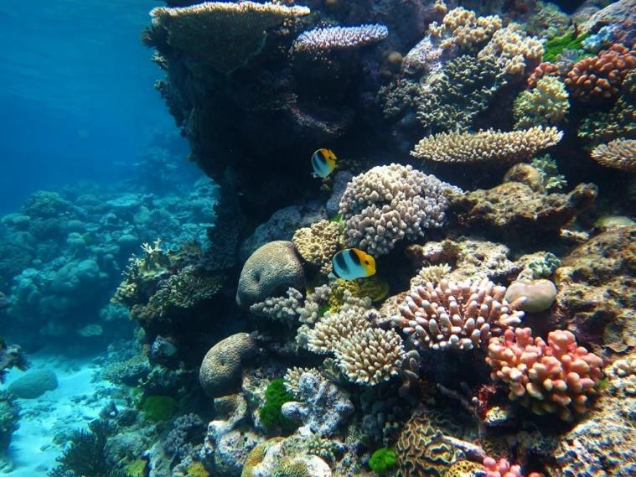
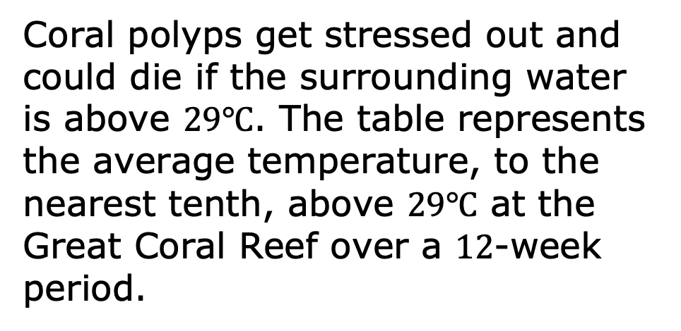
5.3.1 Warm-Up: Which One is the Best?
Coral polyps get stressed out and could die if the surrounding water is above $29℃$. The table represents the average temperature, to the nearest tenth, above $29℃$ at the Great Coral Reef over a $12$-week period.
volume 1, pg. 215

Slide 7
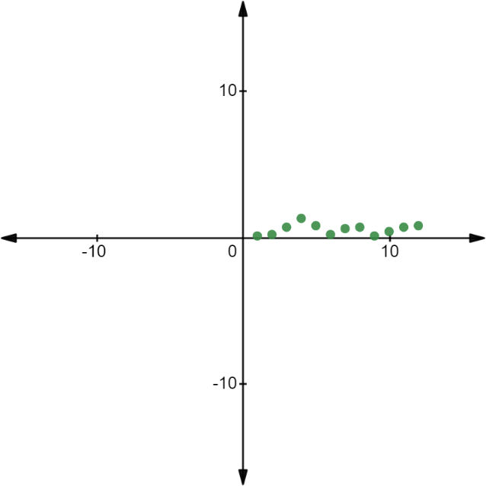
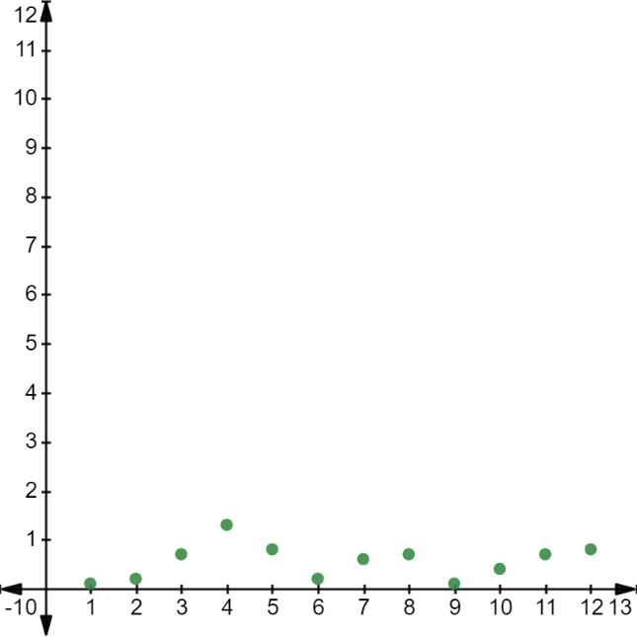
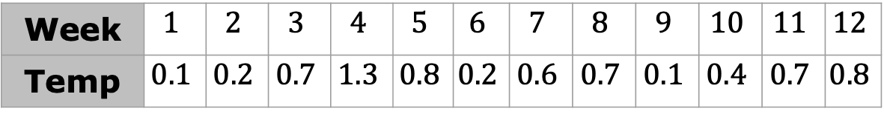
Explain which of the three graphs best represents the data. (Data taken from NOAA.)
Week | $$1$$ | $$2$$ | $$3$$ | $$4$$ | $$5$$ | $$6$$ | $$7$$ | $$8$$ | $$9$$ | $$10$$ | $$11$$ | $$12$$
Temp | $$0.1$$ | $$0.2$$ | $$0.7$$ | $$1.3$$ | $$0.8$$ | $$0.2$$ | $$0.6$$ | $$0.7$$ | $$0.1$$ | $$0.4$$ | $$0.7$$ | $$0.8$$
Graph A
Graph B
volume 1, pg. 215

Slide 8
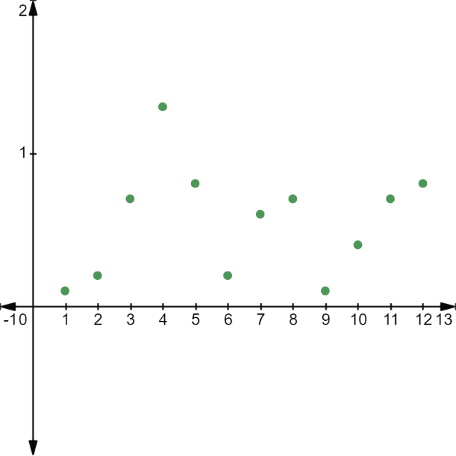
Graph C
volume 1, pg. 216

Slide 9

Collaboration
volume 1, pg. 216

Slide 10

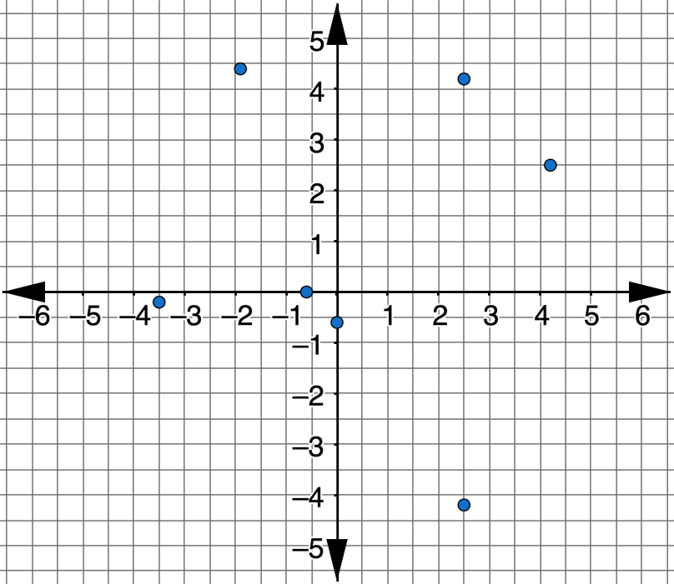
5.3.2 Collaboration: Plotting Points with a Decimal Scale
A coordinate plane is shown.
volume 1, pg. 216

Slide 11
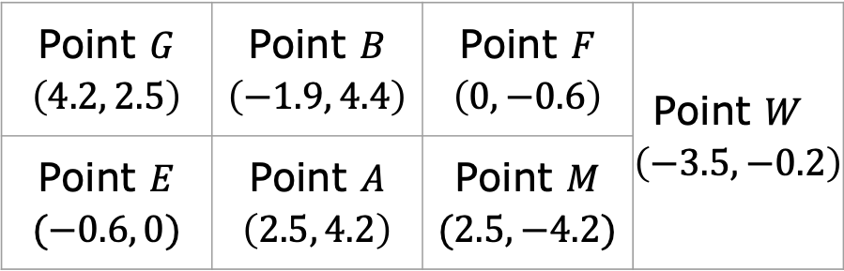
Working with your partner, describe the scale that is being used for each axis.
Locate each point on the coordinate plane and label it with the appropriate letter.
Point $G$ $\left(4.2, 2.5\right)$ | Point $B$ $\left(−1.9, 4.4\right)$ | Point $F$ $\left(0, −0.6\right)$ | Point $W$ $\left(−3.5, −0.2\right)$
Point $E$ $(−0.6, 0)$ | Point $A$ $\left(2.5, 4.2\right)$ | Point $M$ $(2.5, −4.2)$
volume 1, pg. 216

Slide 12
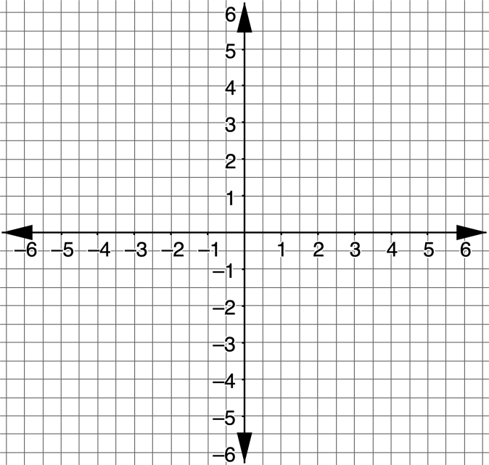
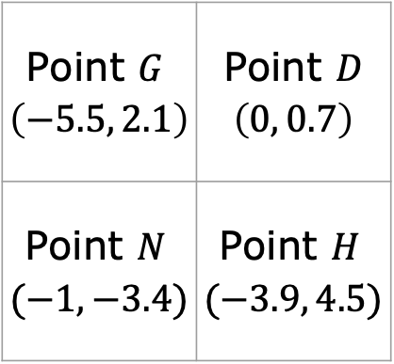
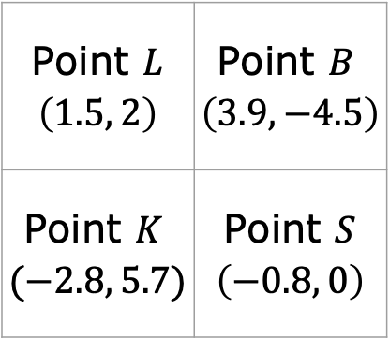
Working with your partner, plot and label the points using the given letters on the grid.
Point $L$ $\left(1.5, 2\right)$ | Point $B$ $\left(3.9, −4.5\right)$
Point $K$ $(−2.8, 5.7)$ | Point $S$ $\left(−0.8, 0\right)$
Point $G$ $\left(−5.5, 2.1\right)$ | Point $D$ $\left(0, 0.7\right)$
Point $N$ $(−1, −3.4)$ | Point $H$ $(−3.9, 4.5)$
Which points were easy to plot?
Which points were more difficult to plot?
volume 1, pg. 217

Slide 13
On your own, answer the following question:
When plotting ordered pairs with decimal values, how is it best to determine the scale to use when setting up the axes on a grid?
My Reasoning
Share your reasoning with your partner and ask for feedback on any parts that were unclear or missing. Make any necessary edits to your reasoning.
volume 1, pg. 217

Slide 14

Try It
volume 1, pg. 218

Slide 15

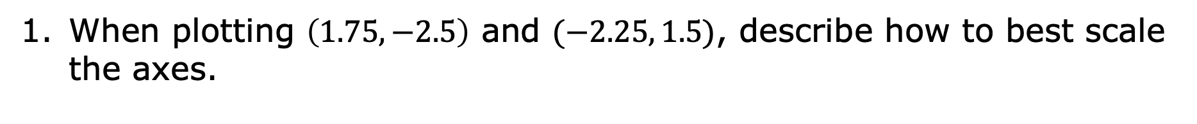
5.3.3 Try It: Plotting Points with a Decimal Scale
When plotting $\left(1.75, −2.5\right)$ and $(−2.25, 1.5)$, describe how to best scale the axes.
volume 1, pg. 218

Slide 16
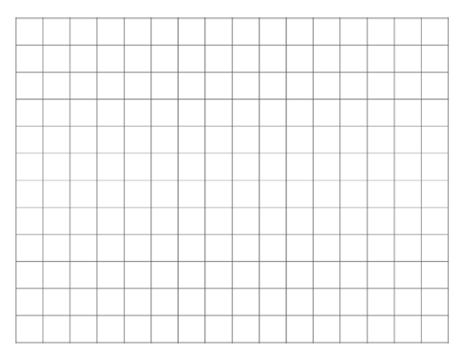
For the points $\left(1.75, −2.5\right)$ and $(−2.25, 1.5)$, draw and label coordinate axes with an appropriate scale, and plot the points.
volume 1, pg. 218

Slide 17

Guided Instruction
volume 1, pg. 218

Slide 18
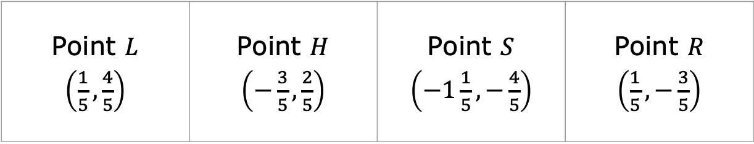
5.3.4 Guided Instruction: Plotting Points with a Fractional Scale
1. Four points are shown.
Based on the denominators of each fraction, what scale should be used for the grid?
Point $L$ $\left(\frac{1}{5}, \frac{4}{5}\right)$ | Point $H$ $\left(−\frac{3}{5}, \frac{2}{5}\right)$ | Point $S$ $\left(−1\frac{1}{5}, −\frac{4}{5}\right)$ | Point $R$ $\left(\frac{1}{5}, −\frac{3}{5}\right)$
volume 1, pg. 218

Slide 19
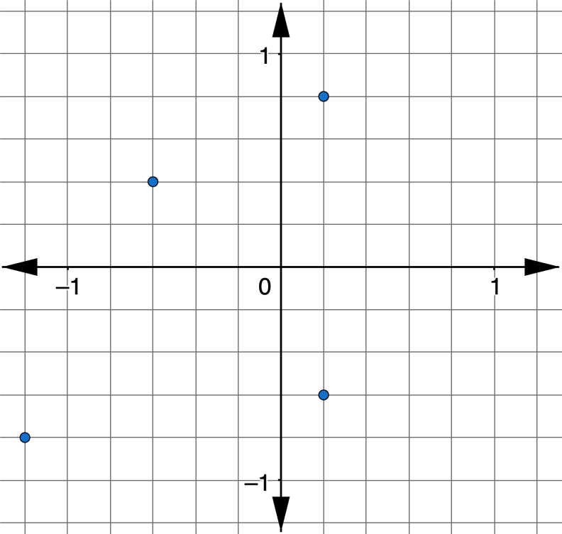
Find and label the points with the given letters on the coordinate plane.
volume 1, pg. 218

Slide 20
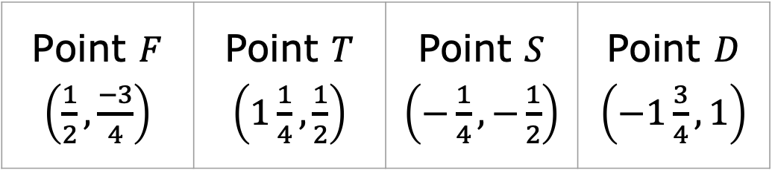
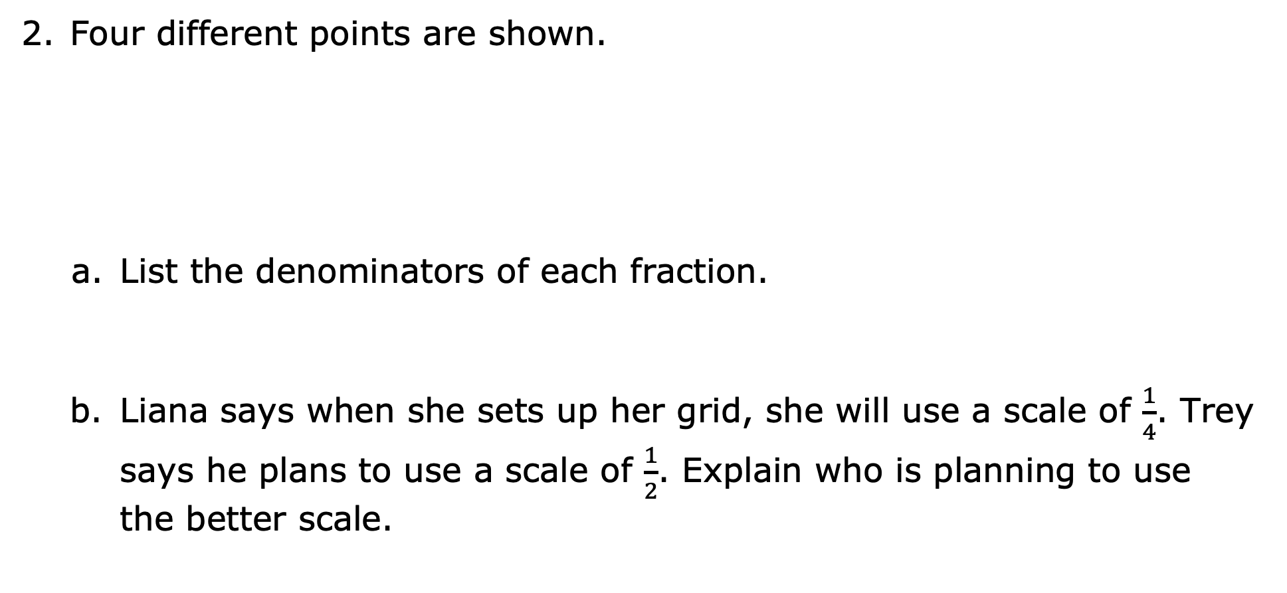
Four different points are shown.
List the denominators of each fraction.
Liana says when she sets up her grid, she will use a scale of $\frac{1}{4}$. Trey says he plans to use a scale of $\frac{1}{2}$. Explain who is planning to use the better scale.
Point $F$ $\left(\frac{1}{2}, \frac{−3}{4}\right)$ | Point $T$ $\left(1\frac{1}{4}, \frac{1}{2}\right)$ | Point $S$ $\left(−\frac{1}{4}, −\frac{1}{2}\right)$ | Point $D$ $\left(−1\frac{3}{4}, 1\right)$
volume 1, pg. 219

Slide 21
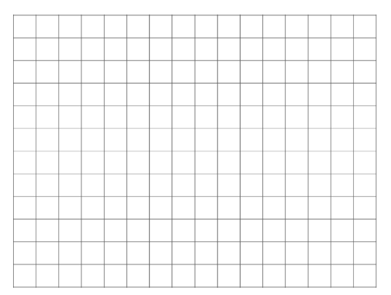
Draw and label coordinate axes with the scale of your choice. Then, plot and label the points.
volume 1, pg. 219

Slide 22
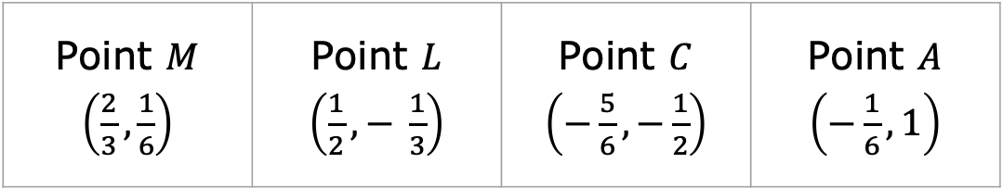
Another set of four points is shown.
List the denominators of each fraction.
Point $M$ $\left(\frac{2}{3}, \frac{1}{6}\right)$ | Point $L$ $\left(\frac{1}{2},− \frac{1}{3}\right)$ | Point $C$ $\left(−\frac{5}{6}, −\frac{1}{2}\right)$ | Point $A$ $\left(−\frac{1}{6}, 1\right)$
volume 1, pg. 219

Slide 23
Zoe says she does not want to label her axes by halves because she will only be able to approximate the location of the thirds. She also says she does not want to label by thirds because there is no easy way to approximate the location of the halves. Christopher says she should label her axes by sixths.
Explain the benefit of using Christopher’s plan.
volume 1, pg. 219

Slide 24
Draw and label coordinate axes with the scale you chose and plot the points.
volume 1, pg. 220

Slide 25

When deciding on a scale for plotting ordered pairs with rational values, consider the least common multiple (LCM) of each of the denominators to determine the proper increments.
volume 1, pg. 220

Slide 26
Try It
volume 1, pg. 220

Slide 27
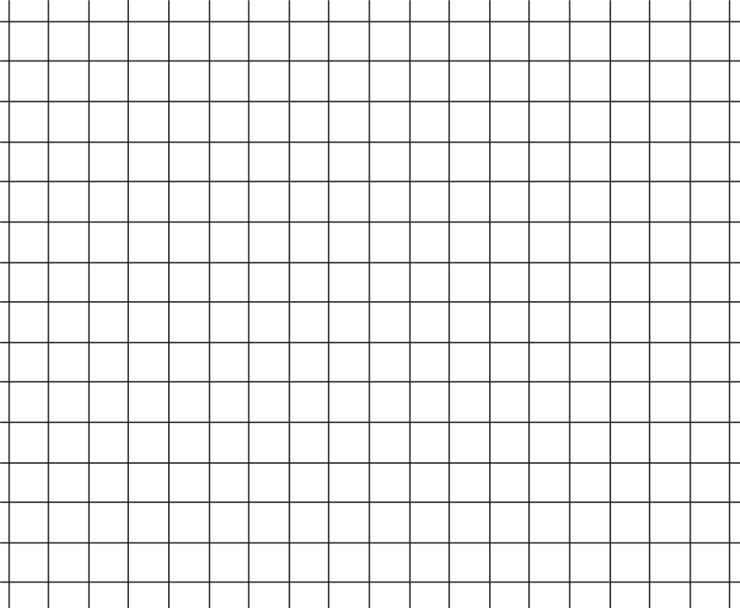
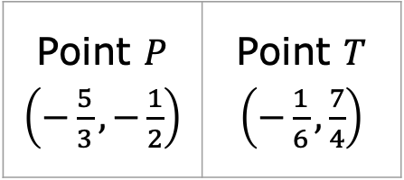
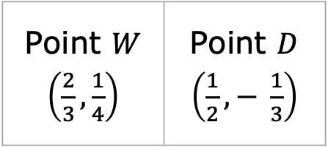
5.3.5 Try It: Plotting Points with Fractions as a Scale
Draw and label coordinate axes with an appropriate scale. Then, plot and label the points.
Point $W$ $\left(\frac{2}{3}, \frac{1}{4}\right)$ | Point $D$ $\left(\frac{1}{2},− \frac{1}{3}\right)$
Point $P$ $\left(−\frac{5}{3}, −\frac{1}{2}\right)$ | Point $T$ $\left(−\frac{1}{6}, \frac{7}{4}\right)$
volume 1, pg. 220

Slide 28

Wrap-Up
volume 1, pg. 221

Slide 29
5.3.6 Wrap-Up: Reflection
Shade the arrow up to the statement that best describes your current level of understanding.
 | I’m so confident, I could explain plotting ordered pairs made up of fractions and/or decimals to someone else!
 | I can get to the right answer, but I don’t understand it well enough to explain it yet.
 | I understand some of this, but I don’t understand all of it yet. I checked the boxes I think I do not understand.
 | I tried hard and I listened, but I am finding this challenging. I checked the boxes I think I do not understand.
volume 1, pg. 221

Slide 30
Check the skills that you currently understand.
Determining the correct scale
Identifying the LCM of the denominators for coordinates that include fractions
Plotting ordered pairs that contain fractions
Plotting ordered pairs that contain decimals
volume 1, pg. 221

